Slide 1



STR Aggregator

Slide 2
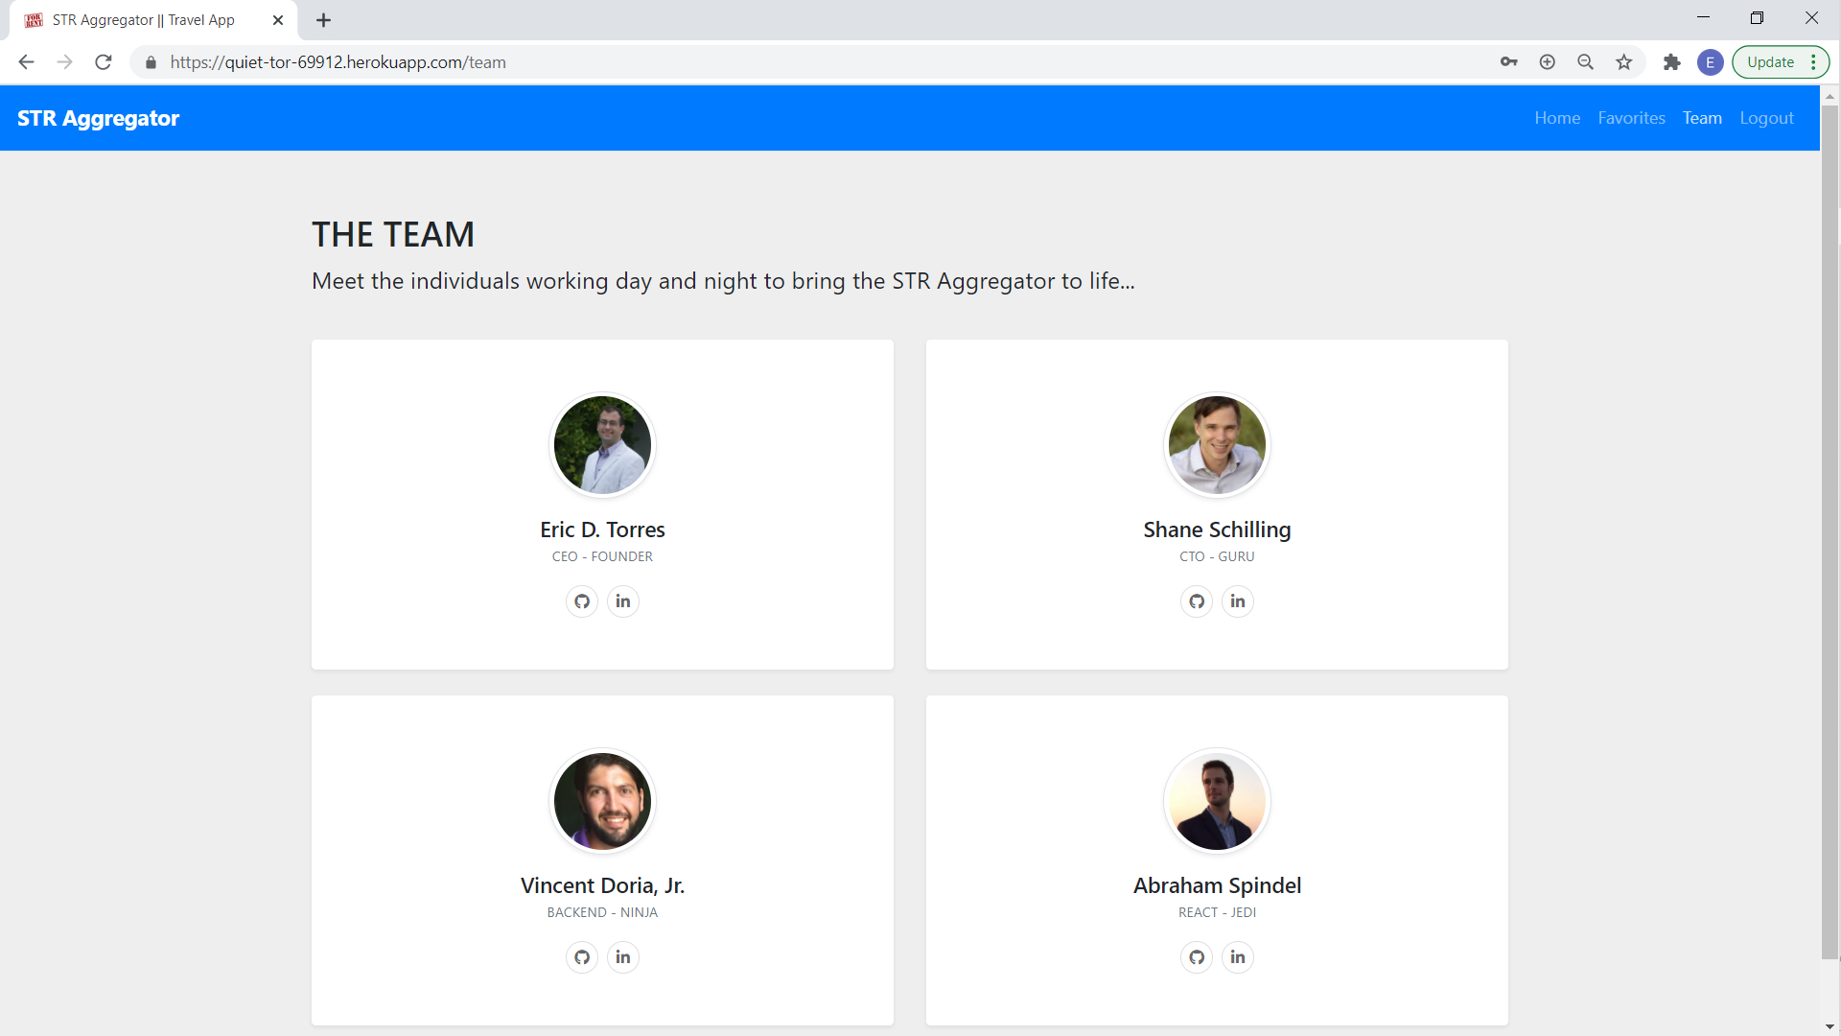
STR Aggregator - TEAM

Slide 3
STR Aggregator-TECHNOLOGIES
Root File (dev server) –
Axios
Bcrypt
Cheerio
Compression
Conurrently
Dotenv
Express
If-env
Jsdom
Mongoose
Morgan
Nodemon
Passport
puppeteer
Client file (react.js) –
Bootstrap
Chart.js
React
React-bootstrap
React Chart.js 2
React-dom
React-router-dom
React-Scripts

Slide 4
STR-Aggregator - FEATURES
React Router for multiple-page SPA
User Authentication
Web Scrapers
MongoDB
Favorites
Travel Budget Creator

Slide 5
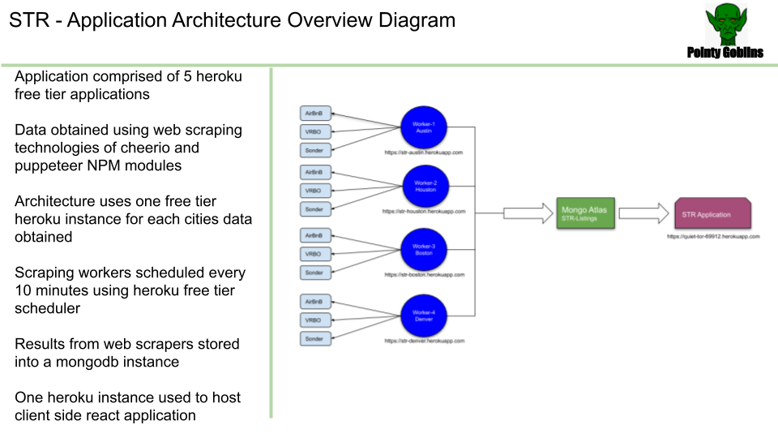

Slide 6

STR Aggregator - DEMO
Take it away, Demo MAN!!

Slide 7
STR Aggregator - Improvements

Slide 8

STR Aggregator - QUESTIONS

